Slide 1
Supervised Learning
Decision Trees
Tomas Karpati MD tc.datascience@gmail.com
054-2002430

Slide 2
Decision Trees
ID | Weight | Blood pressure | Smoke | Heart Attack
1 | High | High | Yes | Yes
2 | Normal | Normal | Yes | No
3 | Normal | High | No | No
4 | Normal | Normal | No | No
5 | High | Normal | No | No
6 | High | Normal | Yes | Yes
7 | Normal | High | Yes | Yes
8 | High | High | Yes | Yes
9 | Normal | High | Yes | Yes
10 | Normal | Normal | No | No
11 | High | High | Yes | Yes
12 | Normal | Normal | No | No
13 | High | Normal | Yes | Yes
14 | Normal | Normal | Yes | No
ID | Weight | Blood pressure | Smoke | Heart Attack
15 | Normal | High | Yes | ?

Slide 3
Decision Trees
ID | Weight | Blood pressure | Smoke | Heart Attack
1 | High | High | Yes | Yes
2 | Normal | Normal | Yes | No
3 | Normal | High | No | No
4 | Normal | Normal | No | No
5 | High | Normal | No | No
6 | High | Normal | Yes | Yes
7 | Normal | High | Yes | Yes
8 | High | High | Yes | Yes
9 | Normal | High | Yes | Yes
10 | Normal | Normal | No | No
11 | High | High | Yes | Yes
12 | Normal | Normal | No | No
13 | High | Normal | Yes | Yes
14 | Normal | Normal | Yes | No

Slide 4
Decision Trees
ID | Weight | Blood pressure | Smoke | Heart Attack
1 | High | High | Yes | Yes
2 | Normal | Normal | Yes | No
3 | Normal | High | No | No
4 | Normal | Normal | No | No
5 | High | Normal | No | No
6 | High | Normal | Yes | Yes
7 | Normal | High | Yes | Yes
8 | High | High | Yes | Yes
9 | Normal | High | Yes | Yes
10 | Normal | Normal | No | No
11 | High | High | Yes | Yes
12 | Normal | Normal | No | No
13 | High | Normal | Yes | Yes
14 | Normal | Normal | Yes | No
7/7
Smoke
No
Yes
5/0
2/7
3 | Normal | High | No | No
4 | Normal | Normal | No | No
5 | High | Normal | No | No
10 | Normal | Normal | No | No
12 | Normal | Normal | No | No

Slide 5
Decision Trees
7/7
Smoke
ID | Weight | Blood pressure | Smoke | Heart Attack
1 | High | High | Yes | Yes
2 | Normal | Normal | Yes | No
3 | Normal | High | No | No
4 | Normal | Normal | No | No
5 | High | Normal | No | No
6 | High | Normal | Yes | Yes
7 | Normal | High | Yes | Yes
8 | High | High | Yes | Yes
9 | Normal | High | Yes | Yes
10 | Normal | Normal | No | No
11 | High | High | Yes | Yes
12 | Normal | Normal | No | No
13 | High | Normal | Yes | Yes
14 | Normal | Normal | Yes | No
No
Yes
5/0
2/7
BP
2/7
Normal
High
2/2
0/5
1 | High | High | Yes | Yes
7 | Normal | High | Yes | Yes
8 | High | High | Yes | Yes
9 | Normal | High | Yes | Yes
11 | High | High | Yes | Yes

Slide 6
Decision Trees
ID | Weight | Blood pressure | Smoke | Heart Attack
1 | High | High | Yes | Yes
2 | Normal | Normal | Yes | No
3 | Normal | High | No | No
4 | Normal | Normal | No | No
5 | High | Normal | No | No
6 | High | Normal | Yes | Yes
7 | Normal | High | Yes | Yes
8 | High | High | Yes | Yes
9 | Normal | High | Yes | Yes
10 | Normal | Normal | No | No
11 | High | High | Yes | Yes
12 | Normal | Normal | No | No
13 | High | Normal | Yes | Yes
14 | Normal | Normal | Yes | No
7/7
Smoke
2 | Normal | Normal | Yes | No
6 | High | Normal | Yes | Yes
13 | High | Normal | Yes | Yes
14 | Normal | Normal | Yes | No
No
Yes
5/0
2/7
BP
Normal
High
2/2
Wgt
2/2
0/5
Normal
High
2/0
0/2

Slide 7
Decision Trees
ID | Weight | Blood pressure | Smoke | Heart Attack
1 | High | High | Yes | Yes
2 | Normal | Normal | Yes | No
3 | Normal | High | No | No
4 | Normal | Normal | No | No
5 | High | Normal | No | No
6 | High | Normal | Yes | Yes
7 | Normal | High | Yes | Yes
8 | High | High | Yes | Yes
9 | Normal | High | Yes | Yes
10 | Normal | Normal | No | No
11 | High | High | Yes | Yes
12 | Normal | Normal | No | No
13 | High | Normal | Yes | Yes
14 | Normal | Normal | Yes | No
7/7
Smoke
No
Yes
5/0
2/7
BP
Normal
High
2/2
Wgt
0/5
Normal
High
2/0
0/2
15 | Normal | High | Yes | ?
15 | Normal | High | Yes | Yes

Slide 8
Decision Trees
7/7
Smoke
Divide & Conquer algorithm
Split into subset
Are they pure (all 0 or 1)
If yes: Stop
If Not: Goto 1
No
Yes
5/0
2/7
BP
Normal
High
2/2
Wgt
0/5
Normal
High
2/0
0/2

Slide 9
Decision Trees
Root Node: Contains the whole dataset
Branch Node: a division that is not ending the three
Leaf Node: a division that has the highest probability of 1 or 0
Parent Node: is the node from which we divide into branches or leafs
Child Node: is the resulting node of splitting a parent node
7/7
Smoke
No
Yes
5/0
2/7
BP
Normal
High
2/2
Wgt
0/5
Normal
High
2/0
0/2

Slide 10
Decision Trees
Uses tree structure to specify sequences of decisions and consequences
The tree is composed of nodes, branches and leafs
The depth of a node is the minimum number of steps required to search the node from root
The final end node predicts the outcome
7/7
Smoke
No
Yes
5/0
2/7
BP
Normal
High
2/2
Wgt
0/5
Normal
High
2/0
0/2

Slide 11
Decision Trees
Parameters:
Maximum number of branches
Min number of items on node
Measures used to select splits and nodes
Entropy / Gini
Information Gain
7/7
Smoke
No
Yes
5/0
2/7
BP
Normal
High
2/2
Wgt
0/5
Normal
High
2/0
0/2

Slide 12
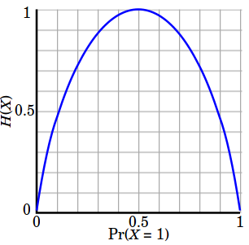
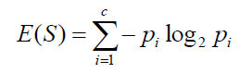
Decision Trees
Measures:
Entropy: measure of randomness or unpredictability of the dataset
If there are two classes it will be:
E(S) = - P₀log₂(P₀) - P₁log₂(P₁)

Slide 13
Decision Trees
Measures:
Entropy: measure of randomness or unpredictability of the dataset
If there are two classes it will be:
E(S) = - P₀log₂(P₀) - P₁log₂(P₁)
7/7
Smoke
E=1.0
No
Yes
5/0
2/7
BP
E=0.75
E=0.0
Normal
High
2/2
Wgt
0/5
Normal
High
2/0
0/2

Slide 14
Decision Trees
7/7
Smoke
E=1.0
Measures:
Weighted average
Avg_{w} = (n_{child-L}/N_{parent})*E_{L} + (n_{child-R}/N_{parent})*E_{R}
No
Yes
E=0.0
5/0
w=0.48
2/7
BP
E=0.75
Normal
High
2/2
Wgt
0/5
Normal
High
2/0
0/2

Slide 15
Decision Trees
7/7
Smoke
E=1.0
Measures:
Information gain: degree of decrease in entropy after a dataset split
No
Yes
E=0.0
5/0
w=0.48
2/7
BP
E=0.75
G=1.00
G=0.64
Normal
High
Information gain
Entropy (parent)
Weights average
Entropy (children)
= - *
2/2
Wgt
0/5
Normal
High
2/0
0/2

Slide 16
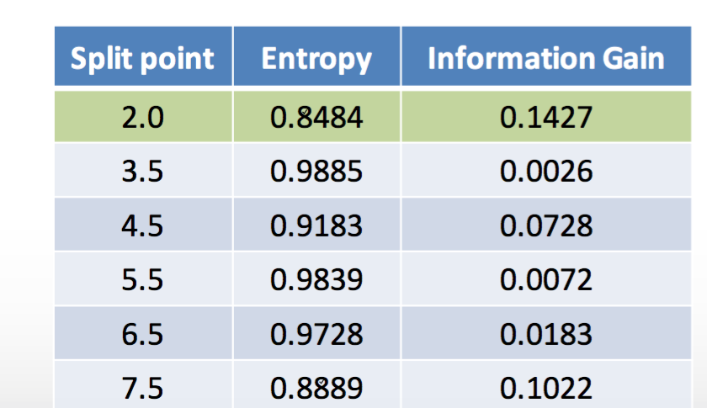
Decision Trees
How decision trees divide continuous variables?
Iterate until all partitions are done
Order the values of the continuous variable
Divide into two group for each partition with at least the selected number of items per node
Calculate the information gain
Select the partition with the highest information gain

Slide 17
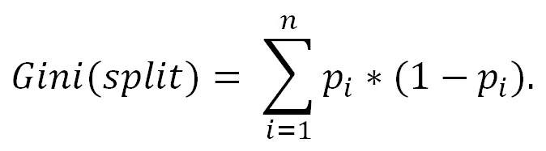
Decision Trees
Types of decision trees
Classification (Entropy | Gini Index, Information Gain)
Regression (Reduction in variance )

Slide 18
Decision Trees
Algorithms
ID3 (Iterative dichotomizer)
C4.5 (Quinlan's next iteration)
C5.0 (Quinlan iteration, patent = closed source)
CART (Classification And Regression Trees) - uses gini index as a measure of purity and uses pruning to reduce overfitting
CHAID (chi-square automatic interaction detector)
MARS (multi-adaptive regression splines, patent = closed source)
CTree (Conditional Inference Trees)

Slide 19
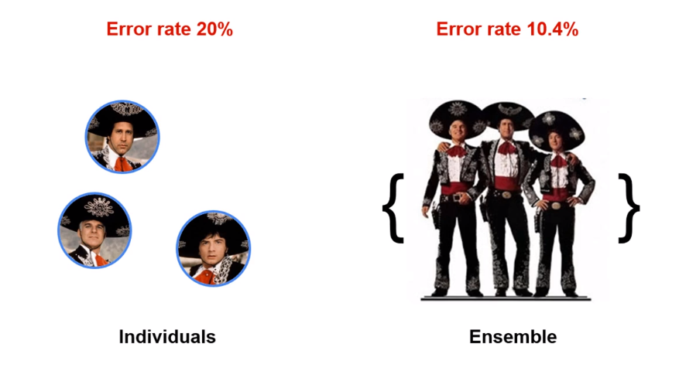
Ensemble Models
https://academy.rapidminer.com/learn/article/ensemble-models-diversity-works-like-magic

Slide 20
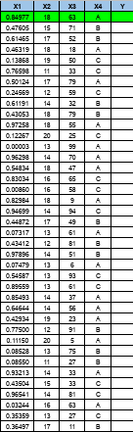
Ensemble Models
1
1
1
0
1
1

Slide 21
Ensemble Models
Ensemble: a technique where a set of weak learners are combined to create a strong learner that obtains better performance than a single one.
There are three factors that cause errors in models: noise, bias and variance.
Ensembling correct those errors.

Slide 22
Ensemble Models
There are two main ensemble techniques:
Bagging:
Random Forest
Boosting:
AdaBoost
XGboost

Slide 23
Ensemble Models
Bagging
Use random sample with replacement - each observation has the same probability of being selected on each sample
The prediction is made by voting (classification) or by averaging the prediction of all the generated models (regression)

Slide 24

Ensemble Models
Bagging
Random
Forest

Slide 25
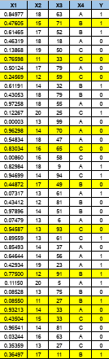
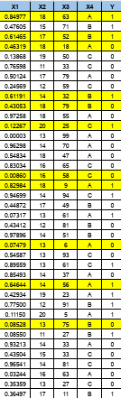
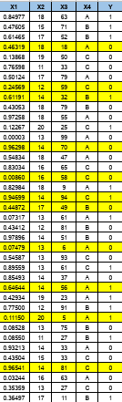
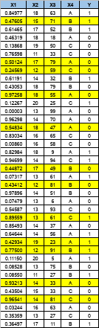
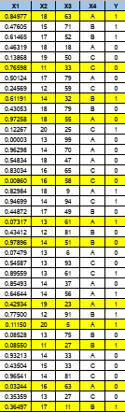
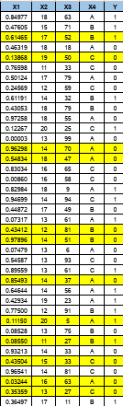
Ensemble Models
Bootstrapping

Slide 26
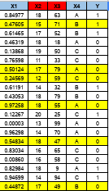
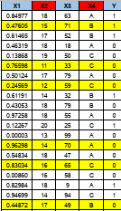
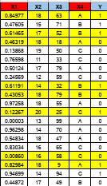
Ensemble Models
Random Forest
Aprox. ⅓ of the data is not used for building the model
Ir is called “out-of-bag” dataset

Slide 27
Ensemble Models
Random Forest
Random forest algorithm used the “out-of-bag” samples to calculate the accuracy of the final prediction
The proportion of “out-of-bag” samples that were misclassified is called “out-of-bag error”.
The initial number of variables to select randomly is the square root of the total number of variables

Slide 28

Ensemble Models
Boosting
AdaBoost
XGBoost

Slide 29
Ensemble Models
Boosting
Use random sample with replacement over weighted data - higher weights are given to misclassified data to emphasise the most difficult cases. Those cases will be more likely to be selected on the sampling phase, so subsequent models could focus on them
The prediction is made by weighting the models. Models with higher accuracy are given higher weights
Some algorithms use a cutoff to delete the poor models

Slide 30
Ensemble Models
Boosting - AdaBoost (Adaptive boosting)
As in bagging the same algorithm is used repeatedly but this time observations are given weights depending if they were well classified or not
Higher weight are given to those incorrectly classified giving them higher probability to appear in the sample
The final outcome is calculated by giving weights to each model. Models with accuracy higher than 50% are given a positive weight while those lower than 50% are given a negative weight. Models with 50% accuracy are discarded

Slide 31
Ensemble Models
Boosting - Gradient Boosting Machine
Based on collection of regression models
Uses gradient descent as their base algorithm
Uses boosting to weight the observations to oversampling those misclassified
Trains model sequentially
Uses the error of the predictions as input on the following models

Slide 32
Ensemble Models
Gradient Boosting Machine
Classification
For correctly classified observations weight is downgraded
For incorrectly classified observations weight is upgraded
Final models with accuracy greater than 0.5 will be given higher importance while those with less than 0.5 will be given lower importance. Those with 0.5 will be discarded

Slide 33
Ensemble Models
Gradient Boosting Machine
Regression:
First model trained on sampled data - calculate error
Second and following models - trained on errors
Errors are calculated for each leaf node using all observations and passed as input variables to the next step
The final model is calculated by weighing up the models that best predict (learns to predict the error)

Slide 34
Ensemble Models
Bagging
Boosting
Random samples
Parallel models
Prediction is calculated by voting or simple mean
Random weighted samples
Serial models
Prediction is calculated by weighting up models with better classification or lower error
w
w
w
w

